Slide 1
Optimized & Flexible Data Science
SCIENCE!!! ☺
Notes:
sudo pip3 install numpy scipy
.5 min

Slide 2
Data Science Modules
Numpy and SciPy both have data science support.
Numpy’s data science functionality is basic, but works well.
SciPy is an advanced scientific library utilizing Numpy.
Both have some support for Calculus operations (e.g., integration).
SciPy in particular has advanced support for Calculus & statistics.
This functionality extends to custom function integration.
Notes:
1.5 min

Slide 3
SciPy: Bounded (Definite) Integration
SciPy can integrate over built-in, custom, and polynomial functions.
from numpy import array, inf
from numpy.polynomial import Polynomial
from math import cos, pi
from scipy import integrate
def inv(x):
return 1 / x
p = Polynomial([1,2,3,4])
print("Integration\n-----------")
print("p, [-1,2]: ", integrate.quad(p, -1, 2))
print("inv, [1,2]: ", integrate.quad(inv, 1, 2))
print("cos, [0,pi]:", integrate.quad(cos, 0, pi))
print("p, ± inf: ", integrate.quad(p, -inf, inf))
print("inv, ± inf: ", integrate.quad(inv, -inf, inf))
print("cos, ± inf: ", integrate.quad(cos, -inf, inf))
p, [-1,2]: (30.0, 3.403725955422978e-13)
inv, [1,2]: (0.693147180559, 7.6954795931e-16)
cos, [0,pi]: (4.922552634974e-17, 2.210223942585e-14)
p, ± inf: (-3.749833808751294, 3.3590961701426316)
inv, ± inf: (0.0, 0.0)
<stdin>:1: IntegrationWarning: The maximum number of
subdivisions (50) has been achieved. If increasing
the limit yields no improvement it is advised to
analyze the integrand in order to determine the
difficulties. If the position of a local
difficulty can be determined (singularity,
discontinuity) one will probably gain from
splitting up the interval and calling the
integrator on the subranges. Perhaps a special-
purpose integrator should be used.
cos, ± inf: (39500218.41439907, 80458078.09222686)
For indefinite integration, take a look at SymPy.
Notes:
13.5 min

Slide 4
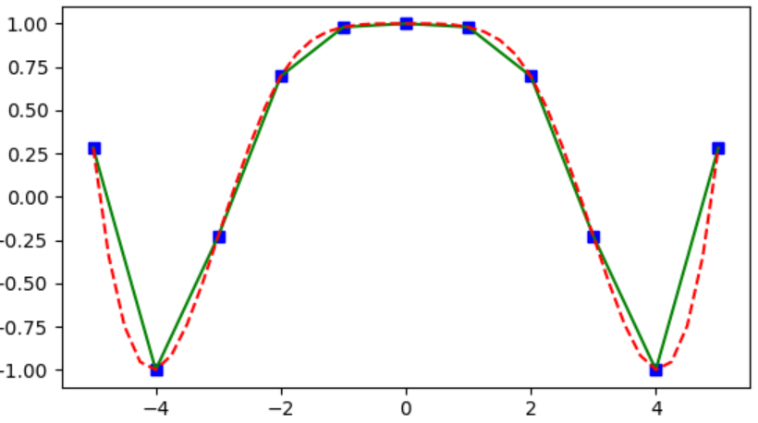
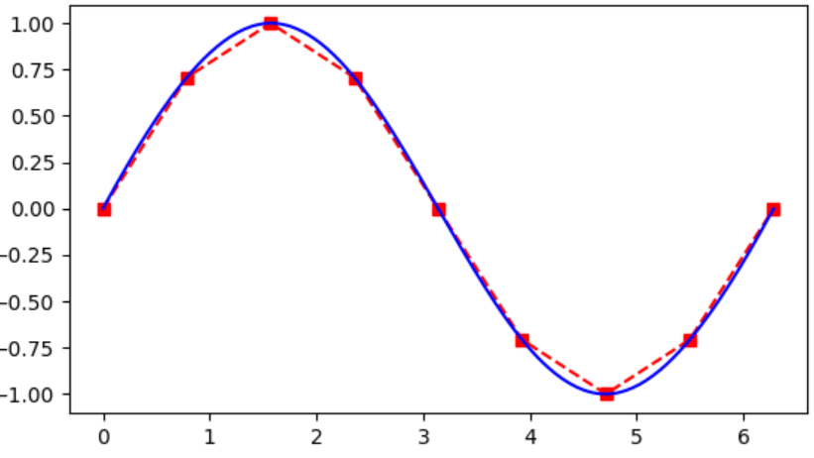
SciPy: Interpolation
We can also interpolate data in several ways.
from matplotlib import pyplot
from numpy import arange, cos, linspace, pi, sin
from scipy.interpolate import interp1d, splrep, splev
x = linspace(-5, 5, 11, endpoint=True)
y = cos(x * x / 5)
f = interp1d(x ,y)
g = interp1d(x ,y, kind="cubic")
xx = linspace(-5, 5, 41, endpoint=True)
pyplot.plot(x, y, "bs", xx, f(xx), "g-", xx, g(xx), "r--")
pyplot.show()
x = arange(0, 7, pi / 4)
y = sin(x)
rep = splrep(x, y)
xx = arange(0, 2 * pi + .03, pi / 100)
yy = splev(xx, rep)
pyplot.plot(x, y, "rs--", xx, yy, "b-")
pyplot.show()
Notes:
11 min

Slide 5
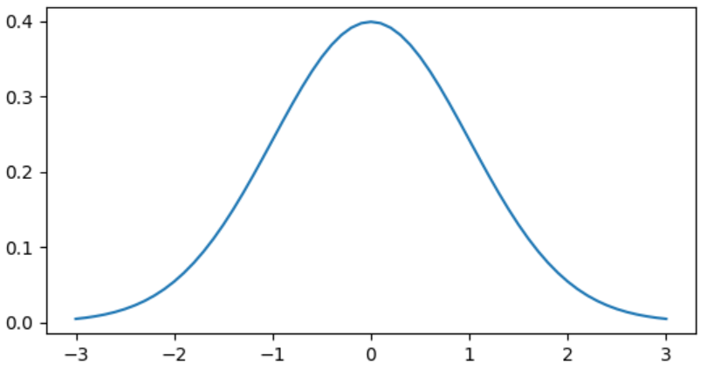
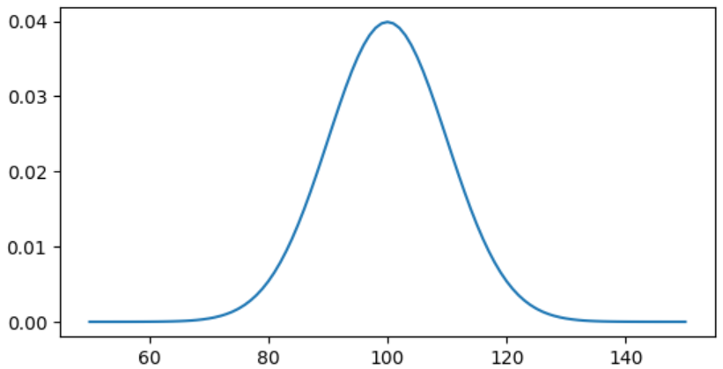
SciPy: Statistics
If you want to do statistics, the “stats” module is where to go.
from matplotlib import pyplot
from numpy import linspace, random
from scipy import stats
# Plot normal distribution, variance = 1, mean = 0
x = linspace(-3, 3, 61, endpoint=True)
y = stats.norm.pdf(x)
pyplot.plot(x, y)
pyplot.show()
# Plot normal distribution, variance = 10, mean = 100
x = linspace(50, 150, 101, endpoint=True)
pyplot.plot(x, stats.norm.pdf(x, 100, 10))
pyplot.show()
# Generate fake data for control / intervention
control = 15 * random.randn(105) + 70 # μ=70, σ=15
intervn = 10 * random.randn(95) + 80 # μ=80, σ=10
# One-way ANOVA
print("F: %f; p: %f" % (stats.f_oneway(control, intervn)))
F: 27.305706; p: 0.000000
Notes:
11.5 min
38 min
Add another short subject?

